Slide 1
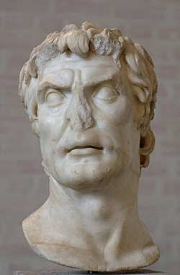
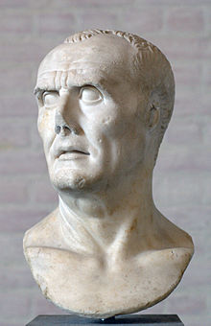
REVISION 2
EST PREPARATION
Week 4, Lesson 1

Slide 2
EST REVISION - Overview
WEEK | Tuesday | Wednesday | Thursday | Friday
3 | X | X | X | Revision 1
4 | Revision 2 | Revision 3 | Revision 4 | Revision 5
5 | EST | Inquiry | Inquiry | Inquiry
6 | Inquiry | Inquiry | Inquiry | Inquiry

Slide 3
Today’s Lesson
Source Analysis Question 1
Source Analysis Question 2

Slide 4
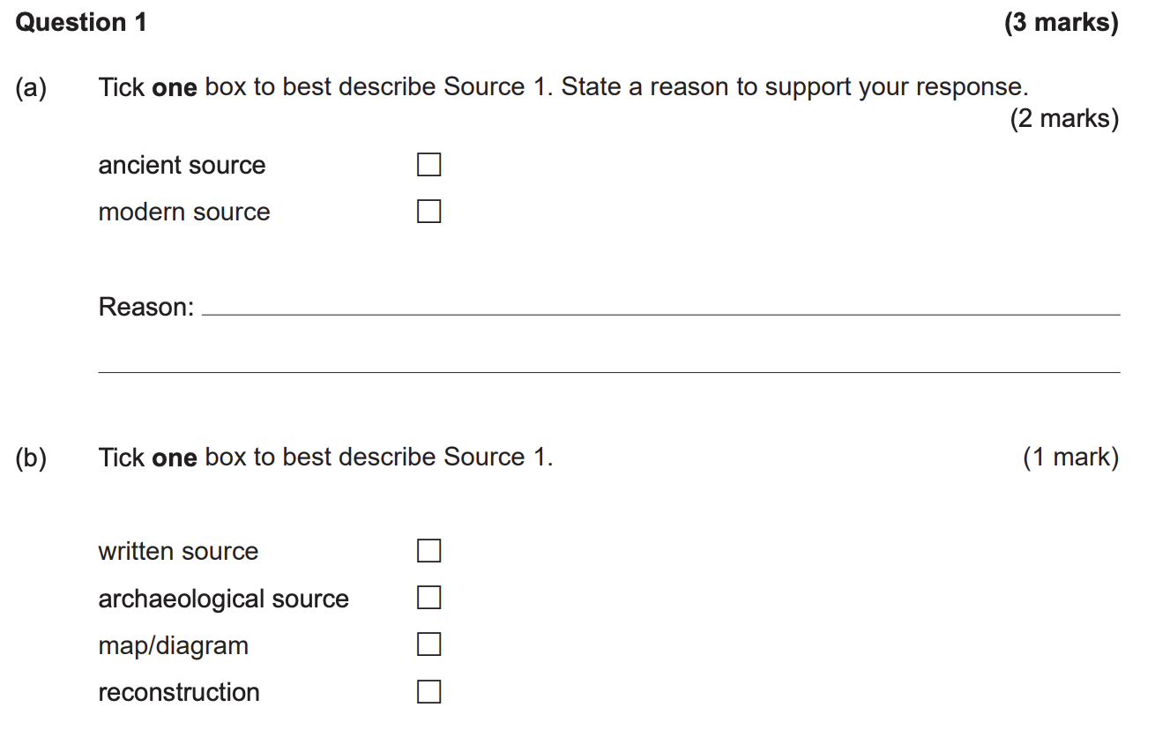
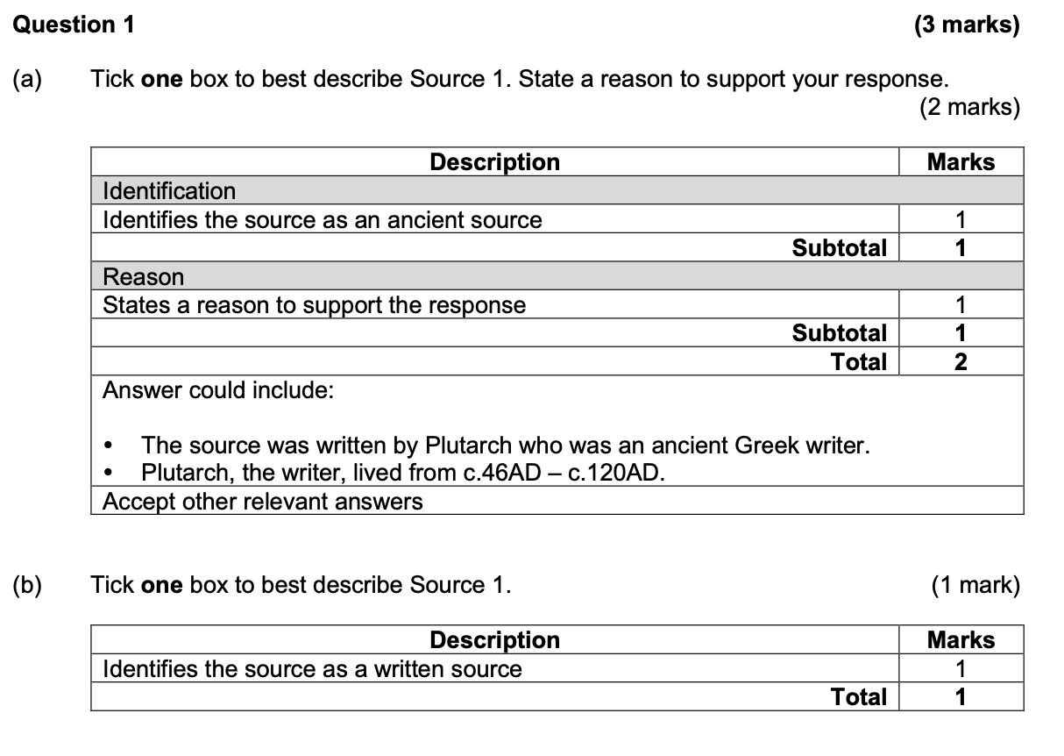
Question 1

Slide 5
Ancient vs. Modern
Ancient history time period extends from 6000 BC to 476 CE (Fall of Rome).
This period extends from c. 500 CE to the present.

Slide 6
REASON:

Slide 7
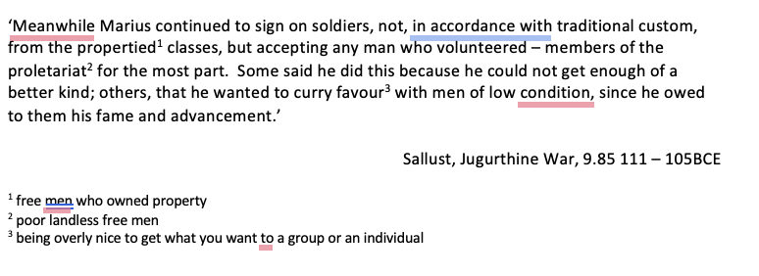

Slide 8
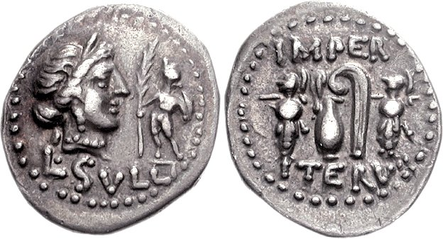

Slide 9
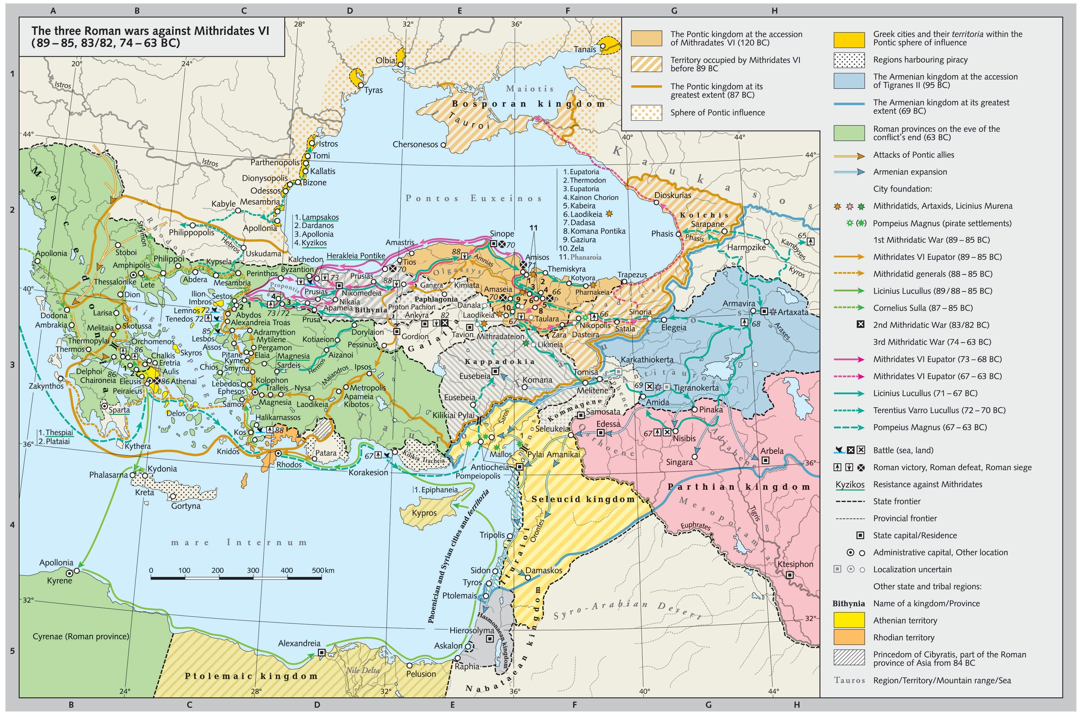
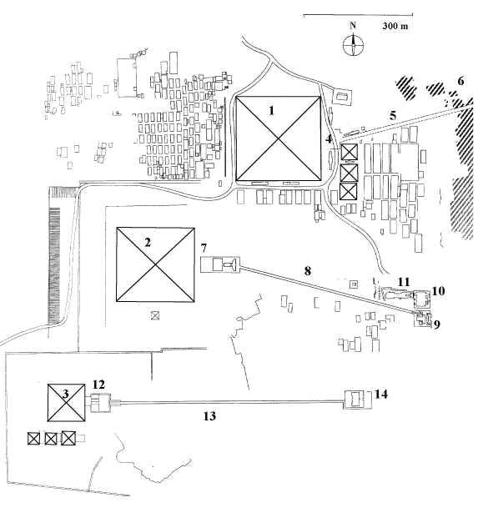

Slide 10
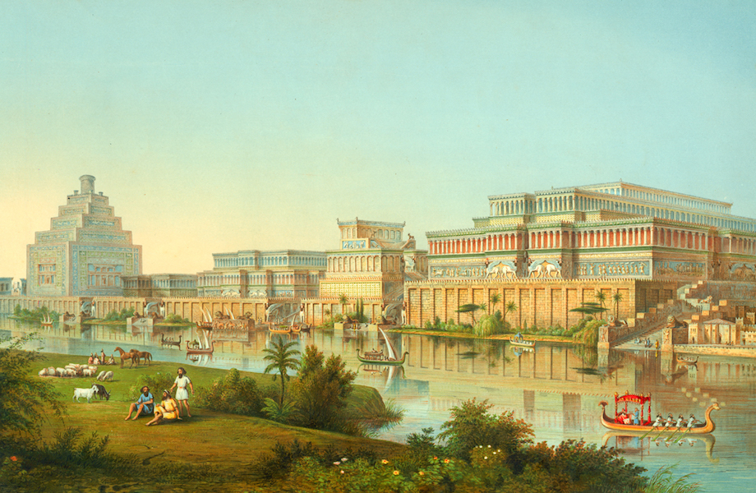


Slide 11
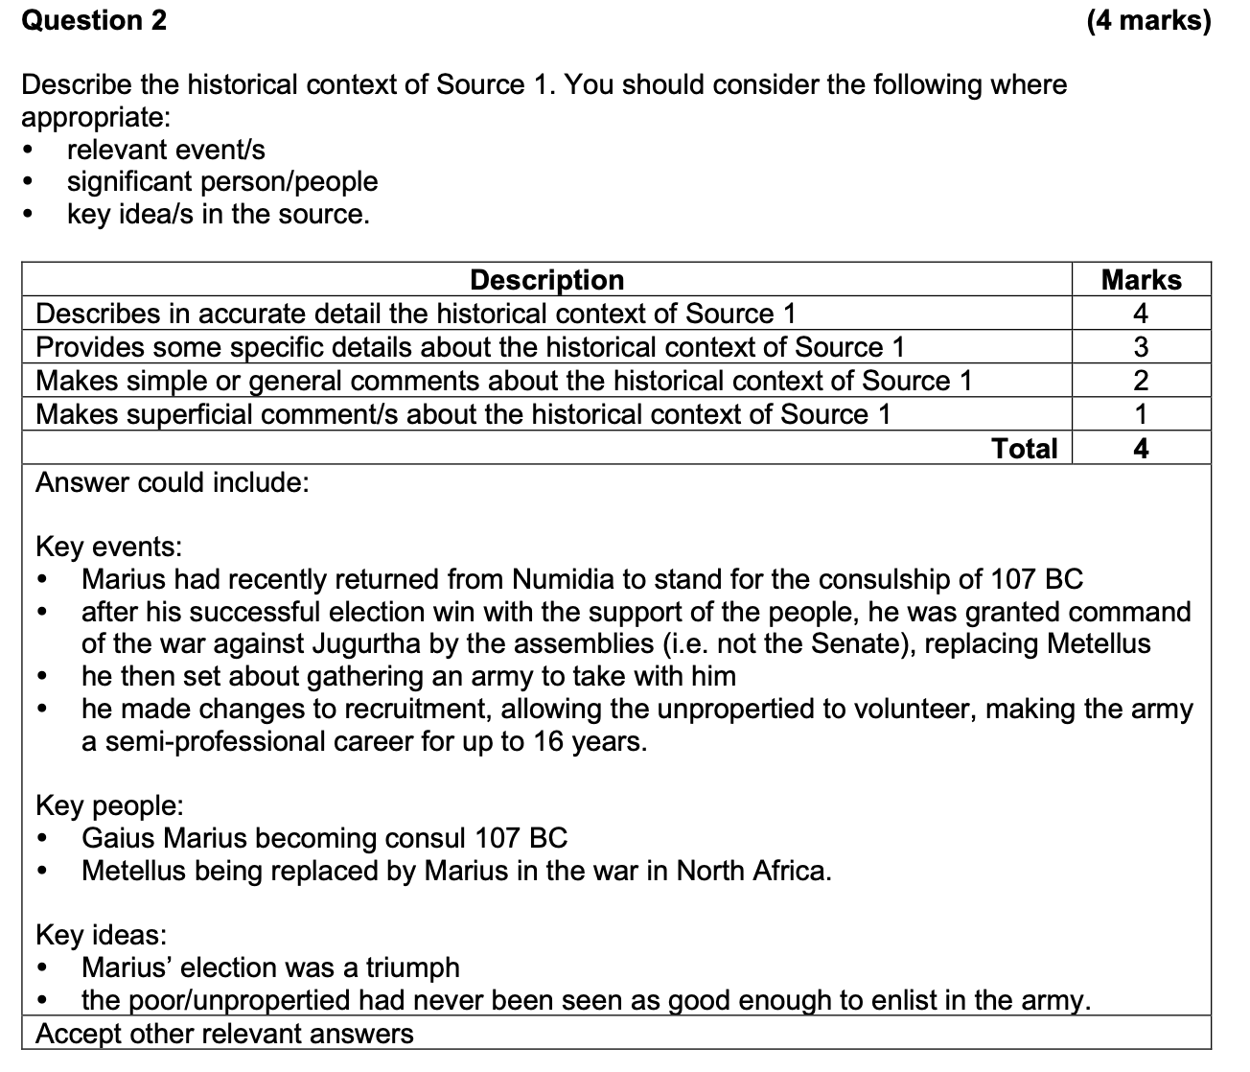
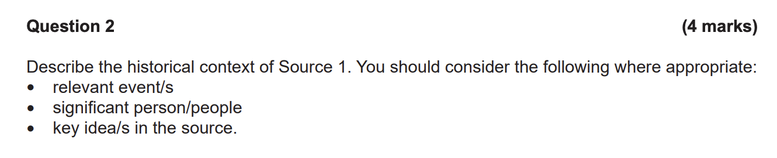
Question 2

Slide 12
Question 2 – How to answer
The focus of Source _______ is ___________________________________ (person, event, idea)
Write what you know about that person, event, idea but be SPECIFIC

Slide 13
Example – Edit/Feedback:
The focus of the source is Gaius Marius. Gaius Marius was a leader in Ancient Rome in the late republic. He was known for his military reforms and made great changes in Rome in many roles like consul. He had extraordinary powers during some military campaigns and made changes to the recruitment and military system in Rome. His rule had many positive impacts (like military changes), and negative (changed perception of soldiers to have loyalty to generals, not the state.

Slide 14
Example – Edit/Feedback:
The focus of the source is Gaius Marius’ return from Numidia to stand for the consulship in 107 BCE. After his successful election win with the support of the people, he was granted command of the war against Jugurtha by the assemblies (i.e. not the Senate), replacing Metellus. Marius then set about gathering an army to take with him. He made changes to recruitment, allowing the unpropertied to volunteer, making the army a semi-professional career for up to 16 years. The poor/unpropertied had never been seen as good enough to enlist in the army, so this was a significant change for Roman society.

Slide 15
Practice Source Analysis
Complete the Source Analysis (10 minutes)
We will mark this together as a class

